Slide 1
Does More crop production Mean Less Hunger?
Crop Production vs Food Security in Africa, 2010–2024
Data Analytics Final Project · WETIN DEY ACADEMY
Presented by: Favour Owoeye

Slide 2
Introduction and problem statement
Despite efforts to boost agricultural output, it remains unclear whether producing more food actually translates into better food security outcomes.
So, this main question was looked into: DOES INCREASE IN AGRICULTURAL (CROP) PRODUCTION GUARANTEE IMPROVED FOOD SECURITY?
Microsoft PowerBI was the tool used to carry out all analysis.
PROBLEM STATEMENT
Africa is rich in land, labour and natural resources for agriculture, yet food insecurity and hunger remain persistent challenges across the continent.
Crop production and undernourishment across African countries, 2010–2024

Slide 3
Analysis questions
Q1
Q2
Q3
Q4
How has total crop production changed across Africa, 2010–2024?
How has undernourishment changed over the same period?
Do countries with fastest production growth also show fastest improving food security?
Which countries grew production but not food security?
Q5
Q6
Q7
Which countries improved food security despite falling production?
Do the five regions show different pattern between production and food security?
Does the data truly support "more production guarantees food security"?

Slide 4
Objectives
1
To examine trends in crop production and undernourishment across Africa, 2010–2024
2
To assess the relationship between production growth and undernourishment at country level
3
To compare patterns between production growth and undernourishment across Africa's five regions
4
To evaluate whether increased production guarantees improved food security

Slide 5
Scope and limitations
Six countries excluded
Undernourishment is an estimate
Crops analysed together
Sudan, South Sudan, Burundi, Equatorial Guinea, Eritrea and Lesotho lack complete data, so country-level findings cover 48 countries.
It is calculated from national food supply, so it can miss hunger within a country.
Total production was used, not crop by crop, because the question is about overall volume.
The data shows the patterns, not the causes. Explaining why needs trade, conflict, price and aid data.
Missing factors
Trade, conflict, food prices, population growth and climate shocks are not in the data.

Slide 6
Data source and description
Crop production
Food security
15,715 rows · 12 columns
9,940 rows · 12 columns
Area harvested, yield and production for 10 staple crops, by country and year.
17 food security indicators by country and year. Prevalence of undernourishment was the insecurity measure used.
fao.org/faostat/en/#data/QCL
fao.org/faostat/en/#data/FS
Source: FAOSTAT (Food and Agriculture Organization Statistical Database) · Africa only · extracted 11 August 2026 · analysed in Microsoft Power BI

Slide 7
Data cleaning and modelling
Crop production
Food security
Removed columns with no analytical value
Checked duplicates: none found
Handled missing values (about 0.7%)
Set the right data types
Standardised text in the Item column
Removed unneeded columns; no duplicates found
Handled missing values (about 23.3%)
Removed the "<" sign from Value ("<2.5")
Renamed Area to Country
Split Year into start and end year, then added Analysis Year
Data model: a Dim_Region table (country and region) links both datasets (many-to-one). DAX measures and calculated columns drive every visual.

Slide 8
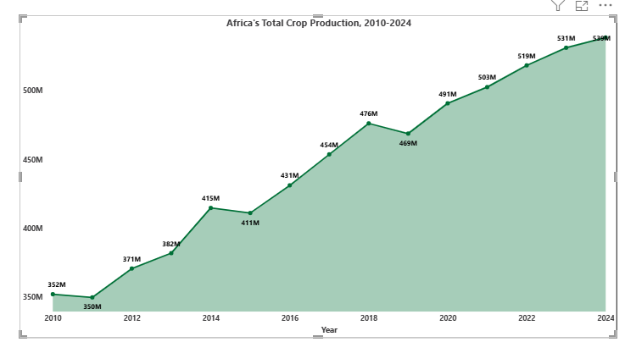
Q1 · How has total crop production changed across Africa?
+53%
Production growth, 2010–2024
INSIGHT
Production rose from about 352M tonnes in 2010 to 539M tonnes in 2024, with some year declines.

Slide 9
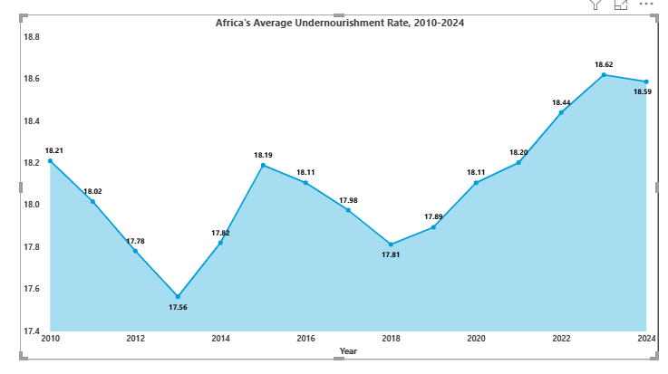
Q2 · How has undernourishment changed across Africa?
18.21% → 18.59%
Average undernourishment, 2010 to 2024
INSIGHT
It reduced to 17.56% in 2013, then reversed and rose to 18.59% by 2024.

Slide 10
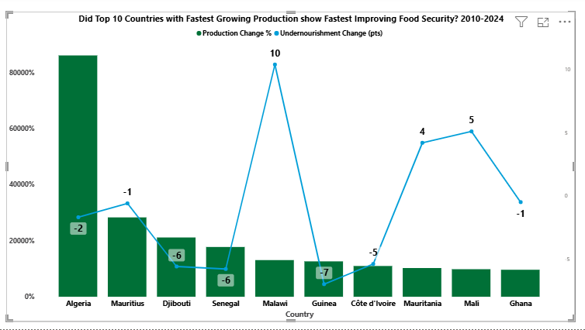
Q3 · Do countries with fastest-production growth show the fastest improving food security?
No clear link
Production growth vs food security change
INSIGHT
Countries with the fastest production growth were not necessarily the ones with the fastest-improving food security.
Malawi’s undernourishment rose by 10 percentage points (pts).

Slide 11
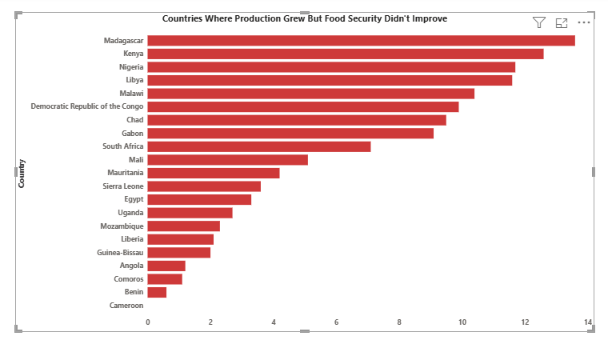
Q5 · Which countries grew production but not food security?
21 of 48
Countries: production up, hunger not improved (44%)
INSIGHT
21 of 48 countries (44%) grew production while undernourishment stayed flat or worsened, i.e. food security did not improve.

Slide 12
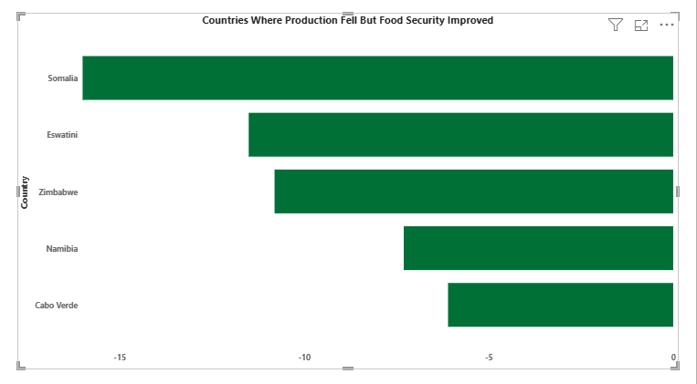
Q6 · Which countries improved food security despite falling production?
5 countries
Hunger fell even though production fell
INSIGHT
Somalia, Eswatini, Zimbabwe, Namibia and Cabo Verde improved food security despite falling production. In Somalia, production fell by 45% while nourishment improved by 16 percentage points (pts).

Slide 13
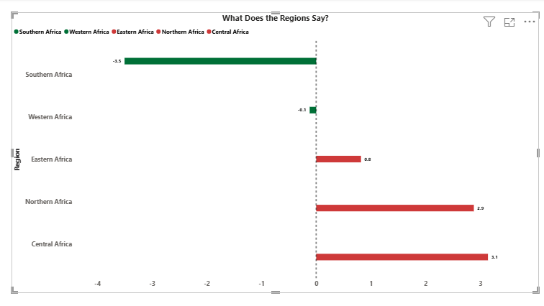
Q7 · Do Africa's five regions show different patterns?
+3.1 vs −3.5
Central vs Southern Africa, average change in points
INSIGHT
Central Africa's undernourishment rose by 3.1 percentage points on average, while Southern Africa's fell by 3.5 points.

Slide 14
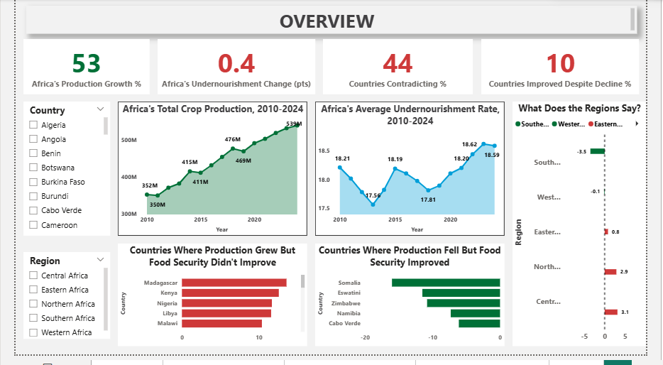
Africa Overview · Country-Level Analysis · Regional Analysis
Dashboard

Slide 15
Recommendations
1
Look beyond the harvest
21 countries grew more food but hunger did not improve. Check the whole journey to the plate: roads, storage, preservation and fair prices.
2
Learn from countries that improved with less output
3
Track hunger, not just harvests
Somalia and four others improved food security despite lower production. Study what worked and test it elsewhere.
Success is not only how much food is grown but how much is secured. Governments should keep tracking food security trends.

Slide 16
Conclusion
Increased crop production does not guarantee improved food security in Africa.
+53%
18.21% → 18.59%
21 of 48
Crop production growth, 2010–2024
Average undernourishment, 2010 to 2024
Countries where production grew but hunger did not improve
Answer to Q8: not guaranteed. Production is one factor among several.

Slide 17
Thank you
Comments, feedbacks?
Data source: FAOSTAT · Analysis: Microsoft Power BI

